Slide 1
Kindergarten admission

Slide 2
CONTENTS
1
Home page
2
Admission page

Slide 3
Home page
Chapter
1

Slide 4
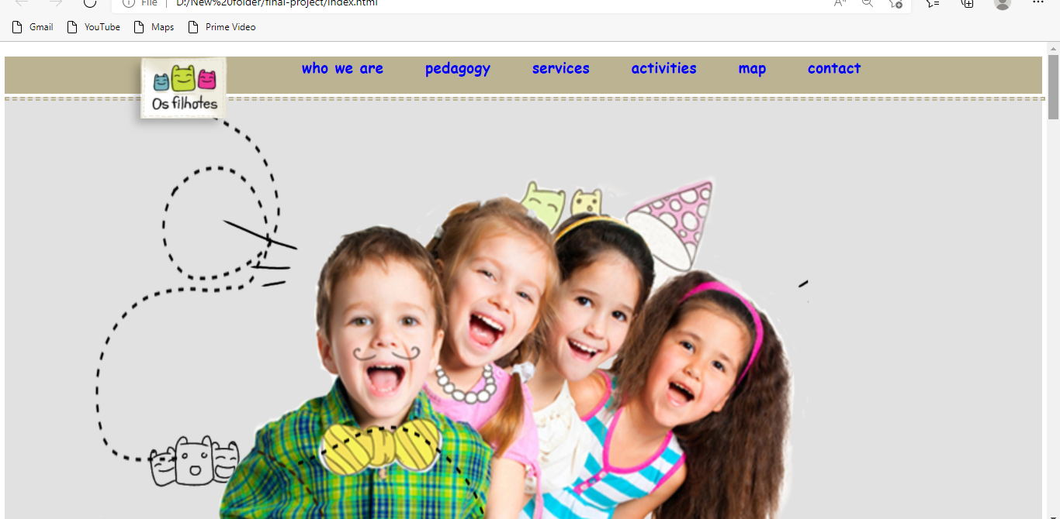
Click here to add the title
Click here to add the text, the text is the extraction of your thought, please try to explain your point of view as succinctly as possible.

Slide 5
Admission page

Slide 6
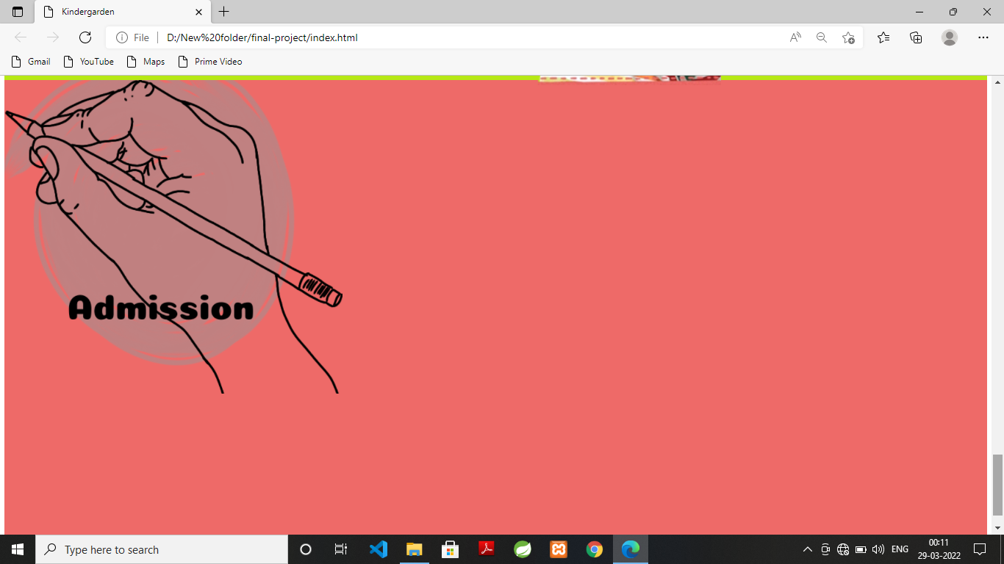

Slide 7
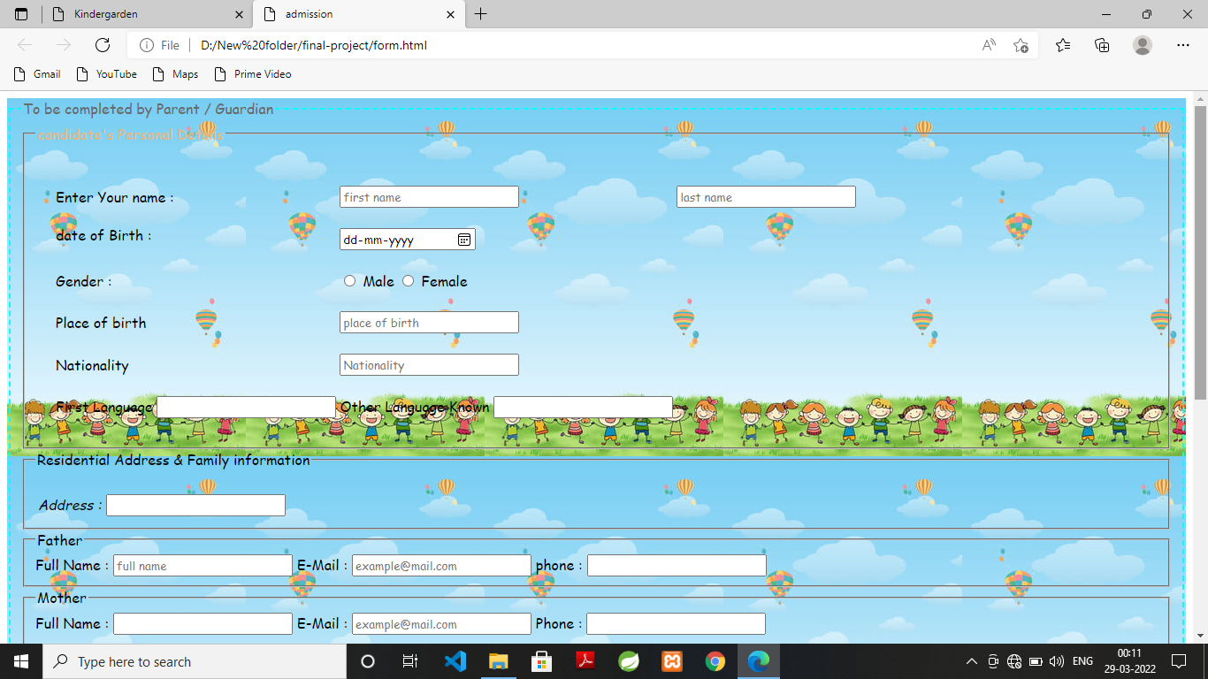

Slide 8
Thank you

